Slide 1

Daily NASA Dashboard
Parth Parashar, Vivian Huynh

Slide 2
Application
This application will be a dashboard for interesting data and photos from NASA about planets, asteroids, etc. We will be using several of the NASA APIs to display new data/photos everyday.
We chose to build this application because it would be interesting to see all the NASA data put together and make it easier to explore the different data NASA has to offer.

Slide 3
Features
Astronomy picture of the day
Pages for different planets with further information
Space news, photos, videos
Searchbar

Slide 4
Stack
Javascript / React
HTML
CSS

Slide 5
APIs
API | Information available | Data Format | Access / Authentication | Cost | Limits
⭐ NASA APIs (multiple) | Images, Earth data, Mars data, satellites, asteroids, etc. | JSON | None | Free | 1,000 requests / hour
REST Countries | Country name, language, capital, etc. | JSON | None | Free | N/A
TheCocktailDB | Drink name, category, instructions, etc. | JSON | None | Free | 100 items

Slide 6
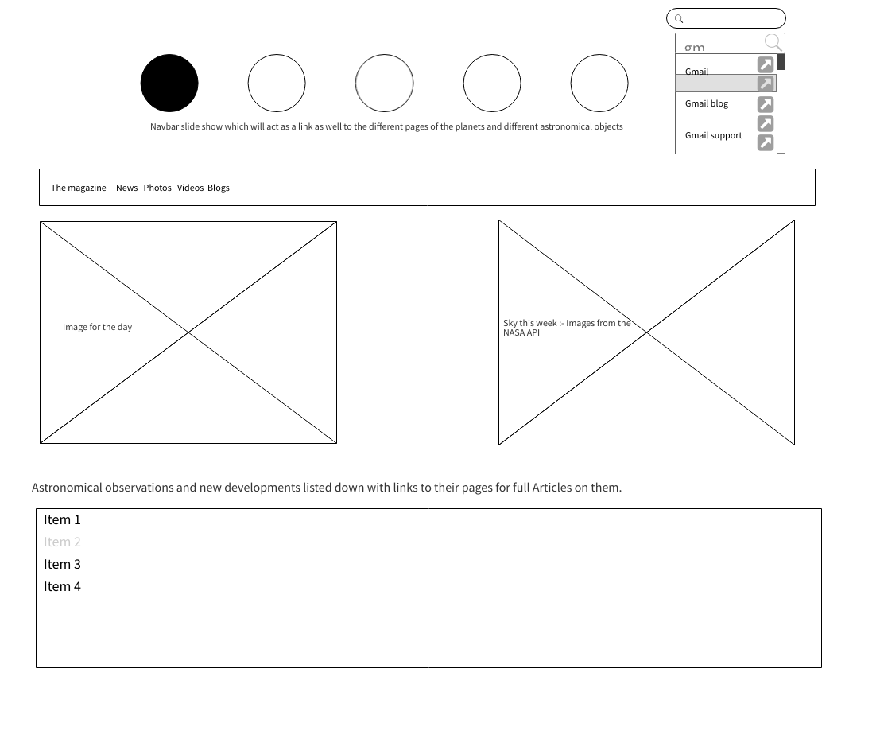
Wireframes
Slideshow nav on the top acting as the HTML links to the astronomical objects shown in the pictures.
Button to switch between the different images on the slideshow navbar
Menu bar containing links to weekly magazine, news, photos ,videos and blogs
Search bar for searching on the website as well as from google as well.
Image for the day
Sky for the week containing daily updated images from NASA API
Links for all the astronomical observations updated from NASA API

Slide 7
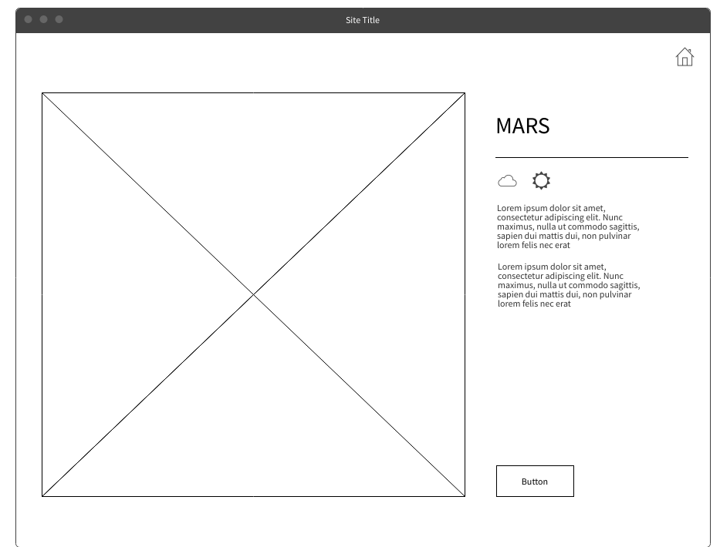
Wireframes
Image from Mars rover on the left from the most recent Martian sol (day on Mars)
Button to switch between different camera views of the Mars rover
Weather on Mars for the most recent Martian sol
Home button to return to home page

Slide 8
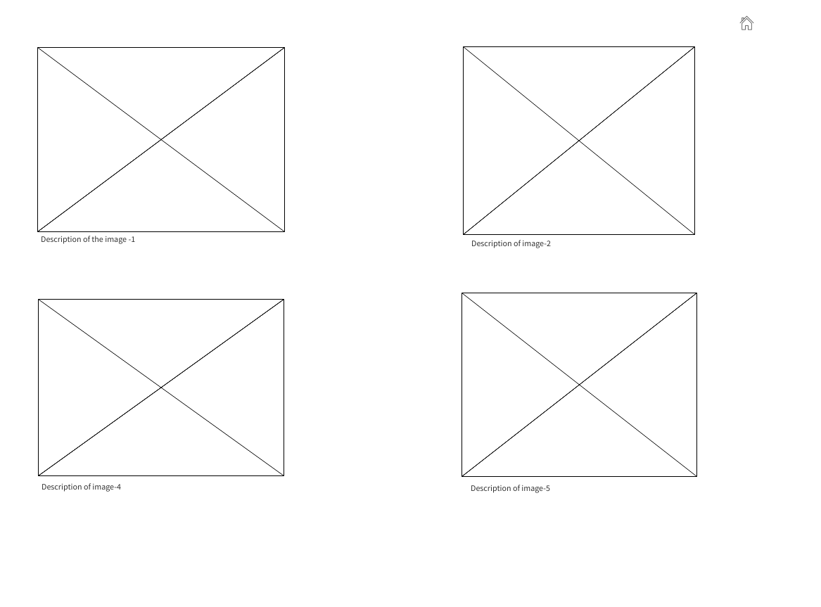
Wireframes
Images from the NASA would be displayed on this
Images will have description below them for the user to know a little more about the image
Home button to return to home page

